Slide 1
EE123 Final Project
Hao He, Xiuneng Lu

Slide 2
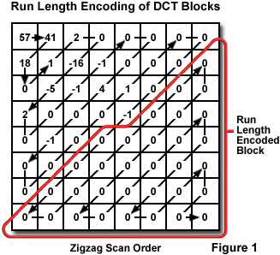
Compression: JPEG-like
Downsampling by 2
8*8 window
DCT+zigzag(discarding 0s after the first 0)
Quantization: Uniform length level, but different number of levels for positive and negative coefficients(26 for positive and 6 of 15 for negative)
Post processing: Median filter to get rid of salt-pepper noise and
wiener filter to sharpen the blurred image.

Slide 3

Communication
ASFK1200, baud = 1200bits/s
make packet using modulatPacket()
send packet using GPIO
receive packet using sd.Stream()
demodulate with decodeAX25()

Slide 4
Work
Not Work
opencv
Upsampling and downsampling of the image
DCT(threshold significant coefficients)
“DIY” Quantization
AFSK1200 transmitting
Gzip
Median filter
AFSK2400 transmitting (transmit rate increase by 2, and the packet sound reasonable
cannot be received & decode)
Wavelet transform (JPEG 2000) (hard to code)

Slide 5
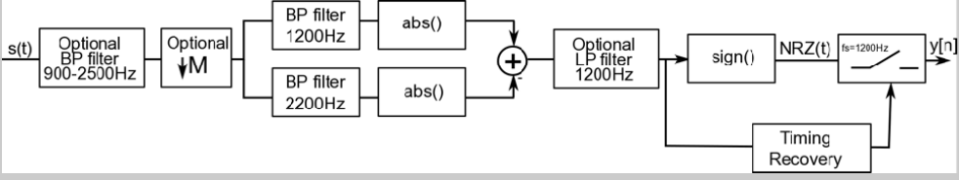
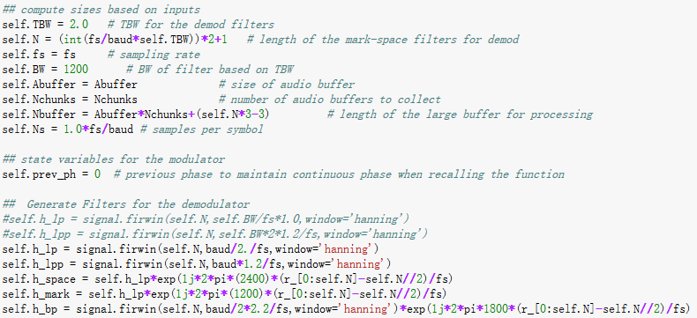

Slide 6
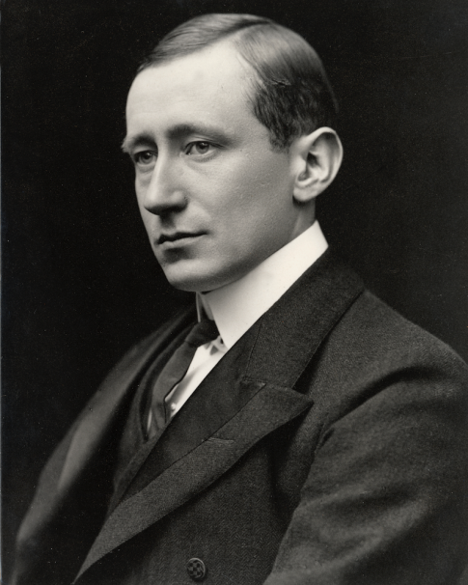
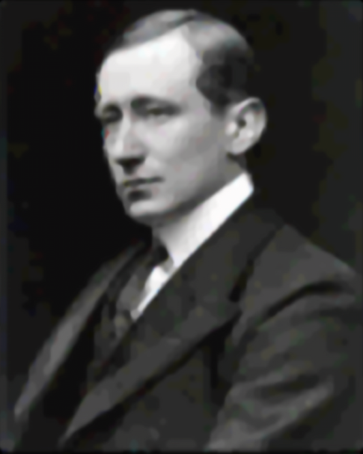
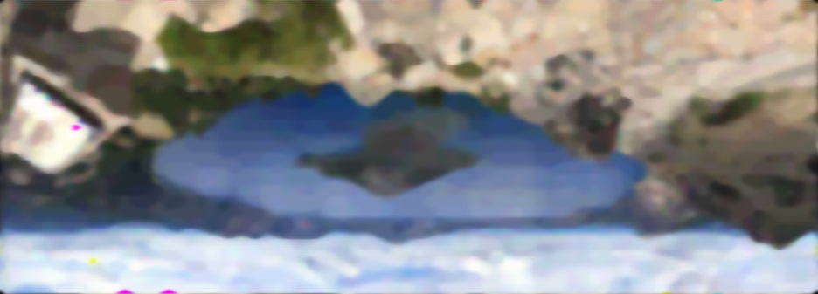

Marconi.bmp
SNR=25.209
createrLake.bmp
SNR=22.26

Slide 7
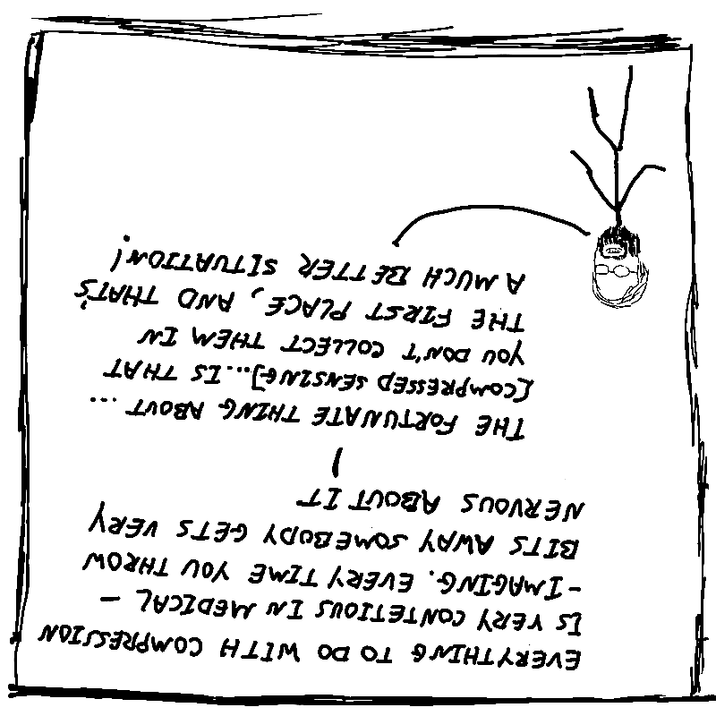
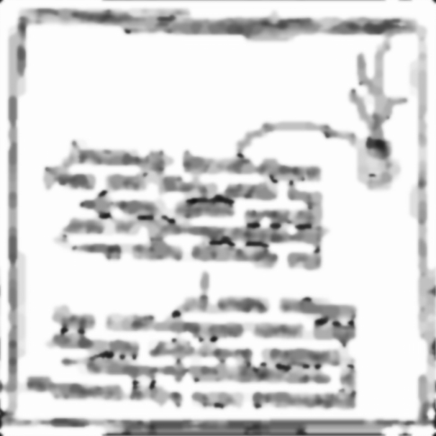
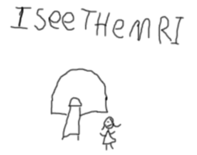
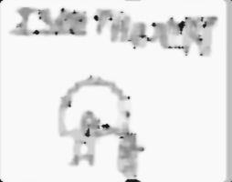

Pauly.bmp
SNR=11.08
Isee.bmp
SNR=17.23
calBlue.bmp
SNR=infinity

